Slide 1



Data Moguls
Team Members: Gregory Woolery, Samuel Matheson, reanna johnson, murphy Facey

Slide 2
Problem
The service being provided by the innovation of data moguls is one that seeks to solve the problem of a lack of affordable and readily available assistance to the visually impaired. There is a gap in this industry as much progress has not been made to ease the burdens of the visually impaired.

Slide 3
Solution to the problem
Our App seeks to solve this problem by providing a user friendly interface for the visually impaired.
This app will guide our target market through their lives with the much needed assistance as well allowing them to maintain a high level of privacy.

Slide 4
Business model canvas segments:

Slide 5
Customer Segment
Visually impaired individuals
Parents/Guardians of visually impaired individuals
The Jamaican Society for the Blind

Slide 6
Value Proposition
Provide remote visual assistance to customers
Visual Aid with privacy
Affordable prices
Convenience, speed of service
Offer subscription discounts

Slide 7
Channels
Mobile App
Social Media (Instagram)
Radio
The Jamaican Society for the Blind

Slide 8
Customer relationship
Build customer focus relationships
Build rapport with customers
Attending to enquiries within 24 hours
Support customer needs
Provide customer support feedback in a timely manner

Slide 9
Revenue streams
Subscriptions for the app-
-Standard
-Gold $2,500/month
-Premium $4,000/month
Added fees for extra assistance- $500/hour

Slide 10
Key resources
Start-up Capital
Network Infrastructure
Programmers
Developers
Staff

Slide 11
Key activities
Granting Subscription requests
Regular App updates
Monitoring staff, staff requests and staff schedules

Slide 12
Key partners
Jamaica Society for Blind People
Insurance Companies

Slide 13
Cost structure
Copyright app name : $3,500
Employees’ salaries :
Employees would be paid based on the amount of hours spent providimg assistance to customers. Assistants will be paid $370/hour per client
Fee for uploading app: 25 USD $3,663 JMD.

Slide 14
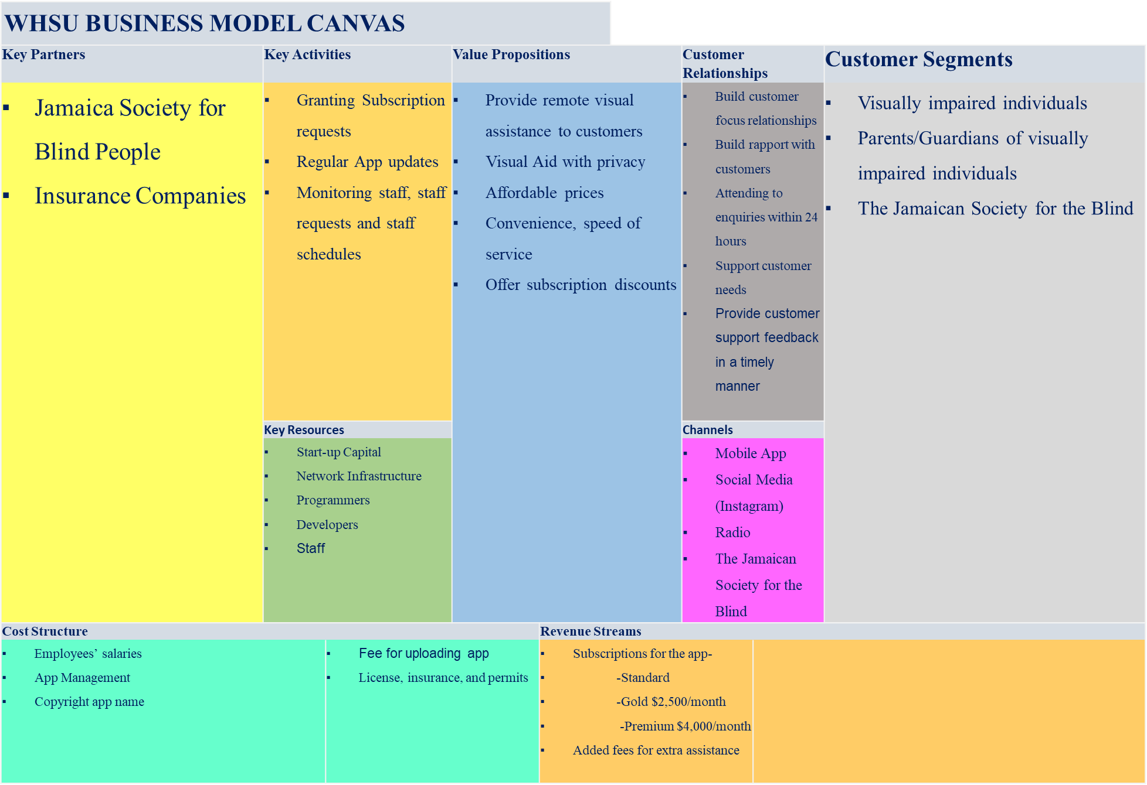

Slide 15
WHSU BUSINESS MODEL CANVAS
Key Partners | Key Activities |  | Value Propositions |  |  | Customer Relationships |  | Customer Segments
Jamaica Society for Blind People Insurance Companies | Granting Subscription requests Regular App updates Monitoring staff, staff requests and staff schedules |  | Provide remote visual assistance to customers Visual Aid with privacy Affordable prices Convenience, speed of service Offer subscription discounts |  |  | Build customer focus relationships Build rapport with customers Attending to enquiries within 24 hours Support customer needs Provide customer support feedback in a timely manner |  | Visually impaired individuals Parents/Guardians of visually impaired individuals The Jamaican Society for the Blind
 | Key Resources |  |  |  |  | Channels
 | Start-up Capital Network Infrastructure Programmers Developers Staff |  |  |  |  | Mobile App Social Media (Instagram) Radio The Jamaican Society for the Blind
Cost Structure |  |  |  | Revenue Streams
Employees’ salaries App Management Copyright app name |  | Fee for uploading app License, insurance, and permits |  | Subscriptions for the app- -Standard -Gold $2,500/month -Premium $4,000/month Added fees for extra assistance

